Slide 1
Applications of Standard Deviation
Notes:
Title page:
Font size 36, bold, theme color of the chapter (red for geometry, blue for algebra, green for statistics)

Slide 2

Test | Angel’s mark | Mean mark of her class | Difference
Chinese | 65 | 62
English | 72 | 68
65 – 62 = 3
72 – 68 = 4
Since the difference between my mark and mean mark of the class is higher in English test, I perform better in English test.

Slide 3
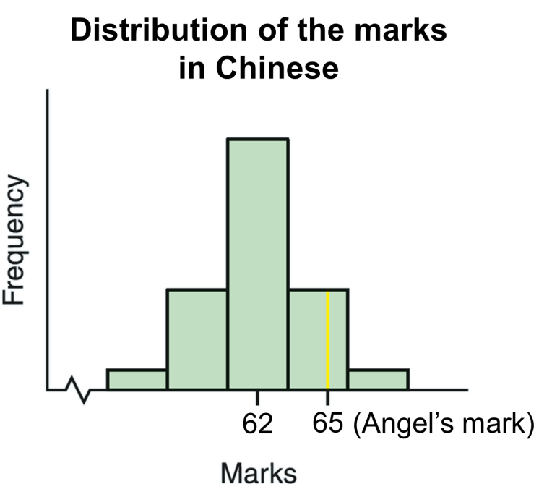
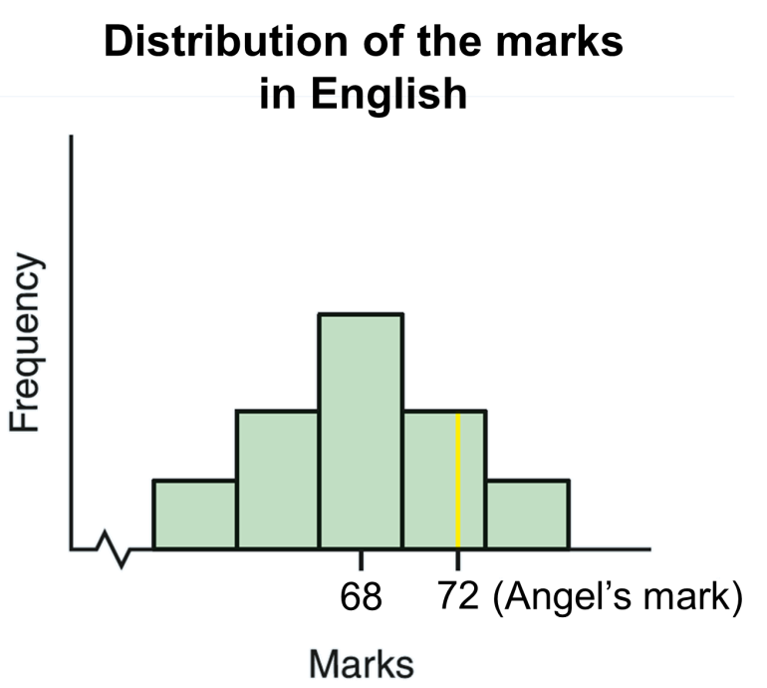

Consider the following histograms which show the distributions of marks of the class in the two subjects.
Angel’s marks are indicated in the distribution by the yellow line.
Let us look into the test results in more details.

Slide 4


In which test, there are less students whose marks are higher than Angel?
Among the two tests, there are less students have marks higher than Angel in Chinese test.

Slide 5
From the above histograms, although the difference between Angel’s mark and the mean mark in English test is higher than that in Chinese test, her performance is better in Chinese test when compared with other students in her class.

Slide 6

From the above example, we can see that Angel’s performance in different tests not only depends on the actual marks or difference from the mean mark, but also depends on the dispersion of the marks in the class.

Slide 7
In statistics, we use a measure called the standard score to compare data from different data sets.

Slide 8

Standard Score
For a set of data with mean x and standard
deviation σ, the standard score z of a given
datum x is defined as
◄ Standard score has no unit.
The standard score measures how far away a datum lies from the mean in units of the standard deviation.

Slide 9
Standard Score
For a set of data with mean x and standard
deviation σ, the standard score z of a given
datum x is defined as
◄ Standard score has no unit.
It is positive when the datum is above mean and negative when the datum is below mean.

Slide 10


For Chinese test,
Angel’s mark (x_{C}) = 65
Class’ mean mark (x_{C}) = 62
Standard deviation (σ_{C}) = 3
For English test,
Angel’s mark (x_{E}) = 72
Class’ mean mark (x_{E}) = 68
Standard deviation (σ_{E}) = 8
Standard score (z_{C})
Standard score (z_{E})
This means that Angel’s
mark in Chinese is 1 standard deviation above the mean.
This means that Angel’s
mark in English is 0.5 standard deviation above the mean.
∵ z_{C} > z_{E}
∴ Angel performs better in Chinese test.

Slide 11
Follow-up question
Refer to the following table.
 | Timmy’s mark | Mean of the class | Standard deviation of the class
Test 1 | 65 | 68 | 6
Test 2 | 72 | 74 | 8
(a) Find the standard scores of Timmy in the two tests.
(b) In which test does Timmy perform better? Briefly
explain your answer.
(a) For test 1,
For test 2,

Slide 12
Follow-up question
Refer to the following table.
 | Timmy’s mark | Mean of the class | Standard deviation of the class
Test 1 | 65 | 68 | 6
Test 2 | 72 | 74 | 8
(a) Find the standard scores of Timmy in the two tests.
(b) In which test does Timmy perform better? Briefly
explain your answer.
(b) ∵ z₂ > z₁
∴ Timmy performs better in test 2.

Slide 13


Normal Distribution
The article says many data sets follow a normal distribution. What is a normal distribution?
Normal distribution is one of the most common and important distributions in statistics. Many kinds of physical and biological measurements such as heights, weights and Body Mass Indexes (BMI) of the population follow the normal distribution.

Slide 14
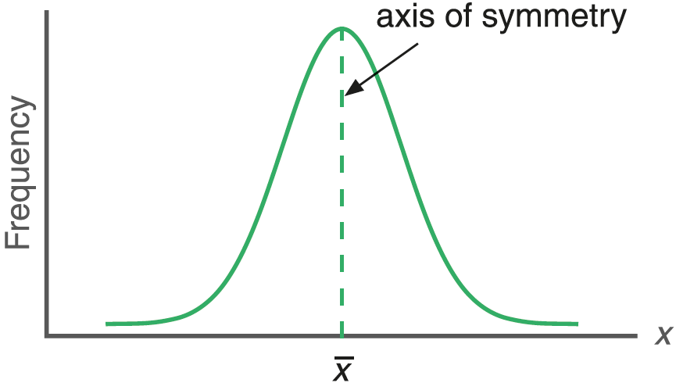
The frequency curve of a normal distribution is represented by a normal curve.
Normal curve
①
The normal curve gets closer and closer to the horizontal axis in both directions, but never touches it.
The mean x and the standard deviation σ of a distribution determine the location and the shape of its normal curve.

Slide 15

The characteristics of a normal curve include:
reflectional symmetry about x = x
Normal curve
bell-shaped
mean, median and mode all equal to x

Slide 16
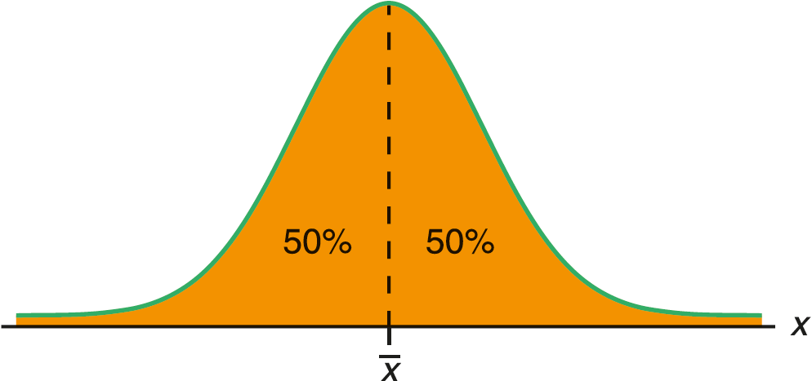
If a set of data follows the normal distribution, it has the following properties.
1. The curve is symmetrical about the mean . So, there are 50% data above , and 50% data below .

Slide 17
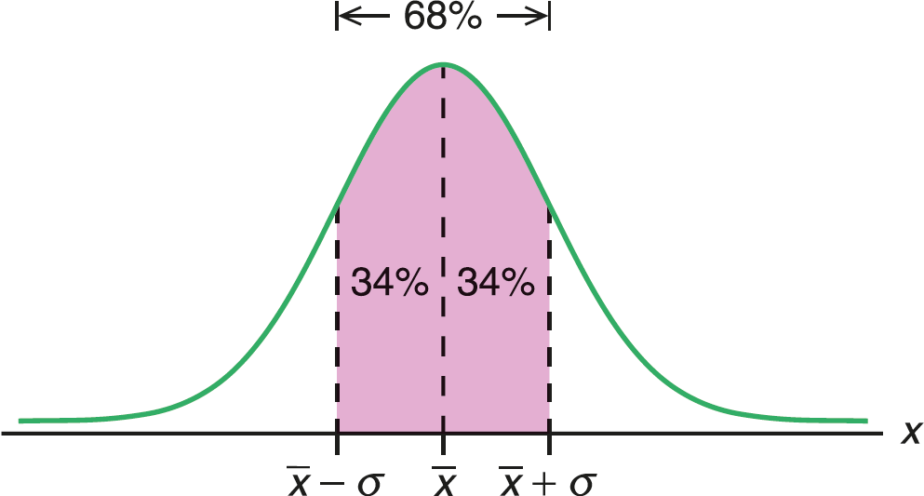
2. About 68% of the data lie within one standard deviation from the mean, i.e. the interval between and
.

Slide 18
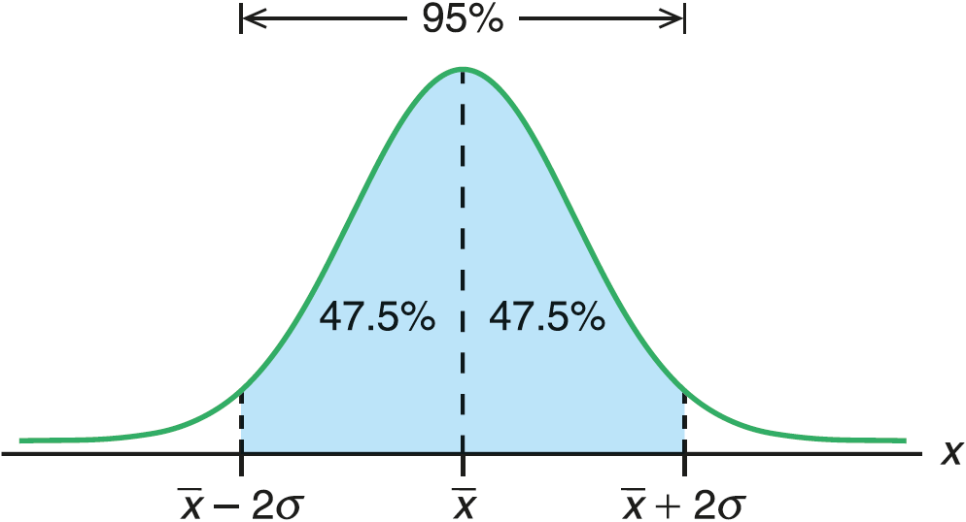
3. About 95% of the data lie within two standard deviations from the mean, i.e. the interval between and .

Slide 19
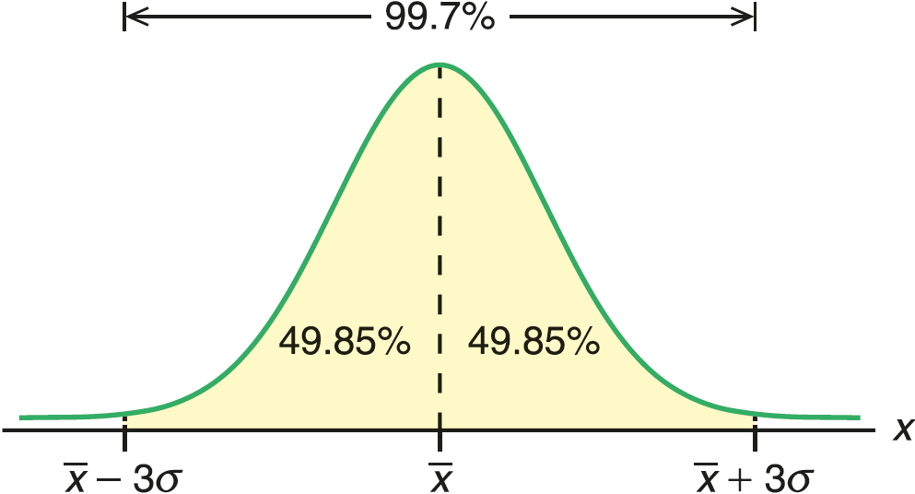
4. About 99.7% of the data lie within three standard deviations from the mean, i.e. the interval between
and .

Slide 20
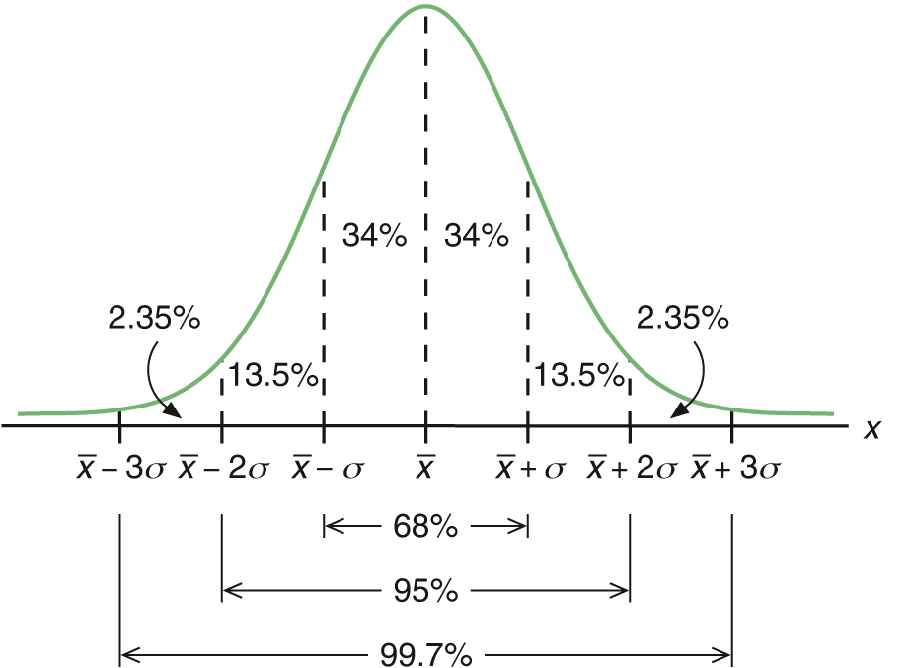
To summarize, we can estimate the percentage of data falling between one, two and three standard deviations about the mean by the following diagram.

Slide 21
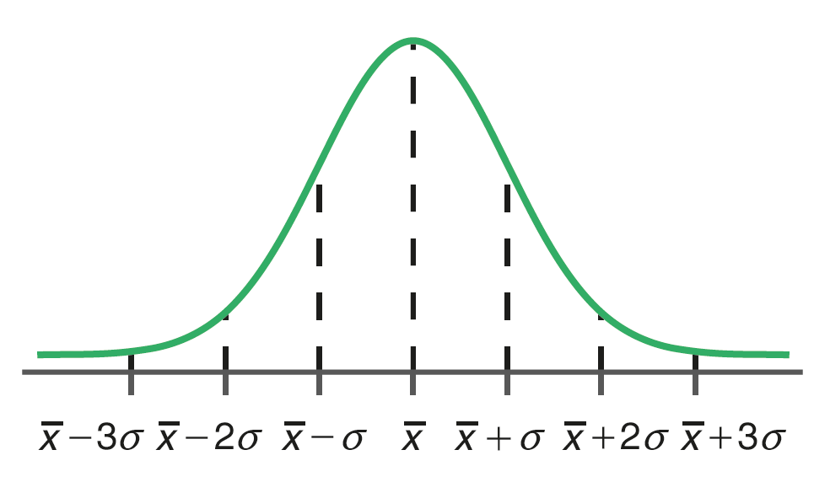
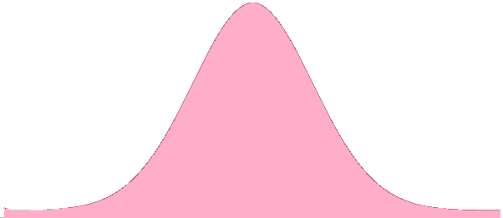
Follow-up question
In each of the following normal curves,
(i) shade the region(s) indicating the data lying in the specified interval,
(ii) find the percentage of data lying in the specified interval.
 | Interval | Normal Curve | Percentage of data
(a) | between and
34%

Slide 22
Follow-up question
In each of the following normal curves,
(i) shade the region(s) indicating the data lying in the specified interval,
(ii) find the percentage of data lying in the specified interval.
 | Interval | Normal Curve | Percentage of data
(b) | between and
97.35%

Slide 23
Follow-up question
In each of the following normal curves,
(i) shade the region(s) indicating the data lying in the specified interval,
(ii) find the percentage of data lying in the specified interval.
 | Interval | Normal Curve | Percentage of data
(c) | Smaller than
97.5%

Slide 24
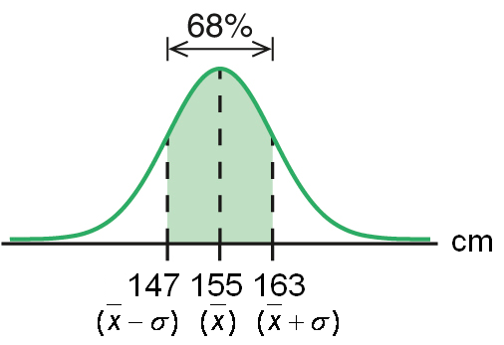
Example:
The heights of 100 students are normally distributed with a mean of 155 cm and a standard deviation of 8 cm.
How many students have heights between 147 cm and 163 cm?
Normally distributed means the data set follows normal distribution.
∵ 147 cm = (155 – 8) cm = x – σ
163 cm = (155 + 8) cm = x + σ
∴ The required number of students
= 100 68%
= 68
③

Slide 25
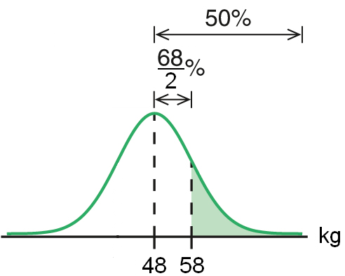
Follow-up question
The weights of 100 students in a school are normally
distributed with a mean of 48 kg and a standard deviation
of 10 kg. Find
(a) the percentage,
(b) the number
of students who are over 58 kg.
(a) ∵ 58 kg = (48 + 10) kg = x + σ
∴ The required percentage
= (50 − 34)%
③
34
=
16
%

Slide 26
Follow-up question
The weights of 100 students in a school are normally
distributed with a mean of 48 kg and a standard deviation
of 10 kg. Find
(a) the percentage,
(b) the number
of students who are over 58 kg.
(b) The required number of students
= 100 16%
=
16

